Slide 1
Containerization and Docker Fundamentals (Hybrid Cloud)

Slide 2
What is a container? (1/2)
Container is a light-weight virtualization technology
Let’s take a use-case to understand where exactly the container fits
ME
Fabric Development Branch
Master
Development for the release 2.0
Go v1.13.4
Release v1.4
LTS
Go v1.12.7
I work in the blockchain domain
One of the developer of Hyperledger Fabric
On a weekly basis, I would work on both development branch

Slide 3

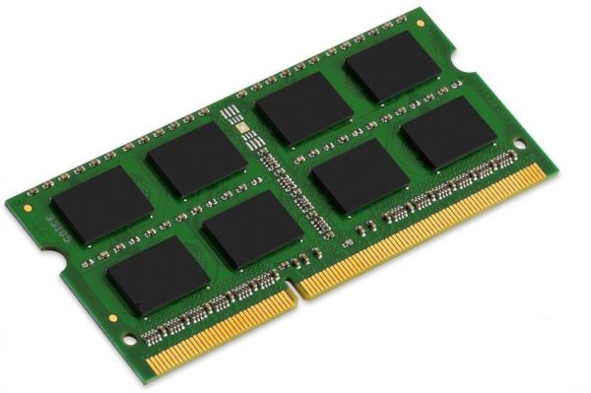
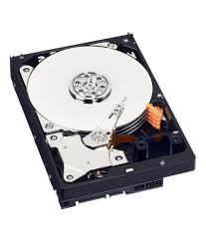
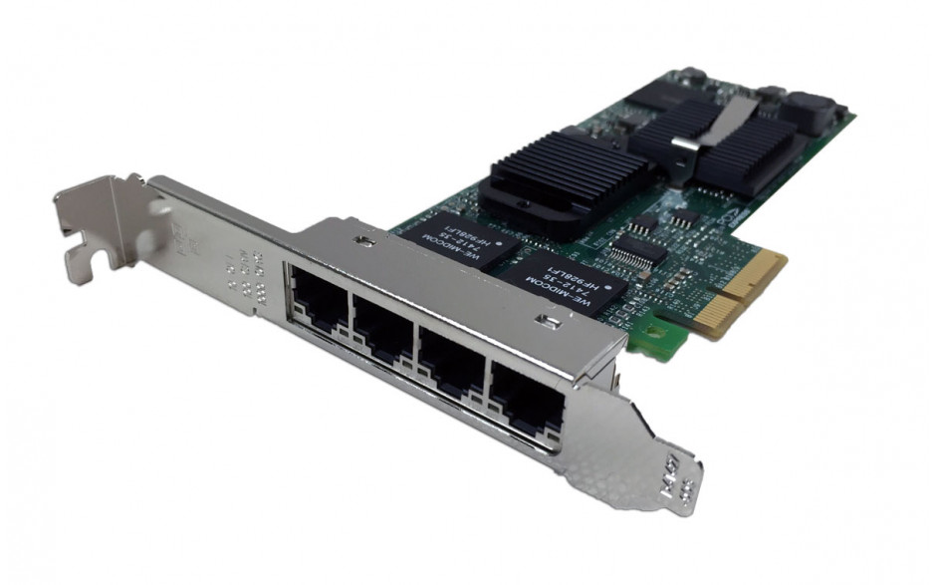
What is a container? (2/2)
Traditional Server (physical machine)
Virtualized Server (virtual machine)
Lightweight Virtualized Server
(container)
Fab-1.4
Fab-master
Fab-1.4
Fab-master
Fab-1.4
Fab-master
Go 1.12.7
Go 1.12.7
Go 1.13.4
Go 1.12.7
Go 1.13.4
OS
Guest OS
Guest OS
OS
Hypervisor
OS
Disadvantage
Complexity in managing multiple version of binaries & libraries
Disadvantage
Higher cost as memory utilization would increase
#Apps that can be hosted would reduce

Slide 4
Other Uses of Container
Write once Use Anywhere.
To easily distribute development environment
To deploy application quickly on multiple servers across private and public cloud (including multi-cloud)
To deploy microservices
To increase server utilization by packing more applications

Slide 5
Tools to Easily and Quickly Create Containers
lxc
Openvz
rkt
Docker

Slide 6
Introduction
As we have already learnt,
Containers are an abstraction of capabilities supported and provided by the Linux Kernel
Containers are hard to start-up through user-programs.
Tools like LXC which pre-dated Docker simplified creation to some extent, but mnt name space and network management remained cumbersome. This gave rise to docker.
Docker is a platform which facilitates packaging and management of distributed applications in containers which have
Low over-head in terms of resources consumed.
Encapsulate all system/context dependencies of the component(s) of the application.
Portable enough to be moved around from one host to another.

Slide 7
Installing Docker
Currently supported on Linux (CentOS, Debian, Fedora, Ubuntu), macOS, Windows 10.
Commands to install Docker on Ubuntu :
sudo apt-get update
sudo apt-get remove docker docker-engine docker.io
sudo apt install docker.io
sudo systemctl start docker (Optional)
sudo systemctl enable docker (Optional)
For more information on installation, visit https://docs.docker.com/install/

Slide 8
Architecture

Slide 9
Big Picture
Docker Daemon: Provides services to the client through RESTful API and json objects. Orchestrates sub-systems.
Docker Client: Provides CLI which in-turn connects to Docker Daemon through RESTful API.
Execution Driver: Manages container life-cycle (start, stop, destroy). Creates the namespaces and control groups, security controls and network for the container. Native execdriver packaged as libcontainer which has subsequently evolved into runC.
Storage Driver: Manages local docker image cache, assembly/disassembly of container file-system.
Local Repositories: Local cache of docker images pulled from a registry or created locally on the host.
Registries: Provide repositories for management of storage and distribution of docker images.
Registries
Docker Client (Eg. CLI)
Docker Daemon
Execution Driver
Docker Remote API
Storage Driver
Containers
Local Repositories

Slide 10
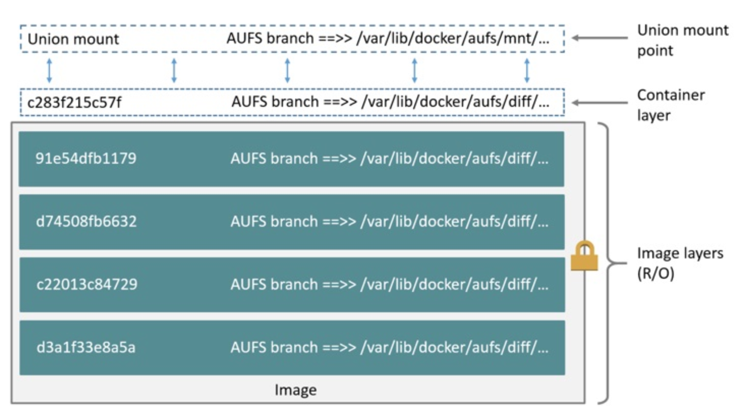
Docker Image And Layers
Docker image is a template which is used to initiate the container.
The image is constituted by several layers, which are combined to create a container.
Except for a “base image”, every layer in the image has a parent.
Images as identified by 256-bit ID which is depicted as a 64-bit ID by docker CLI.
Usually the docker base images are supplied by the DockerHub.
Illustration of ubuntu:latest image. There is a container layer and several read-only layers. The union of these layers form the final ubuntu image.
Source: https://docs.docker.com/storage/storagedriver/aufs-driver/

Slide 11
Docker Registries & Image Names
Registries manage repositories for docker image storage and distribution
Both public and private registries are available. DockerHub [https://hub.docker.com/] is the default registry.
Docker Images are named uniquely using a Fully Qualified Image Name (FQIN) as below:
<Registry Location>/<Namespace>/<Repository Name>:<TAG>
docker.io/library/ubuntu:latest

Slide 12
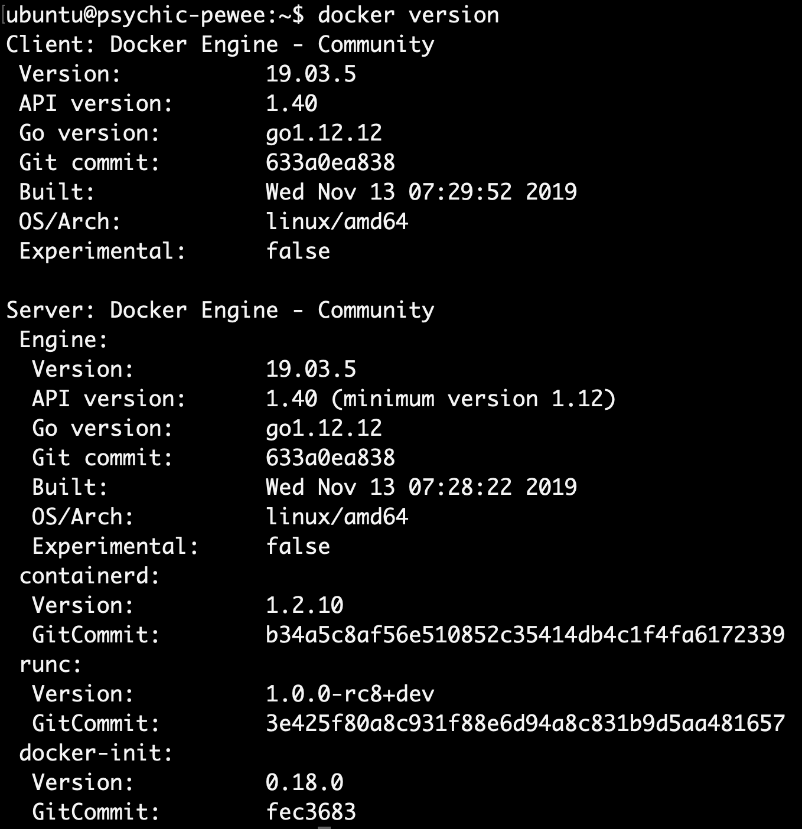
Docker Client
Lists out configuration details
> docker version
Lists out versioning and build details

Slide 13
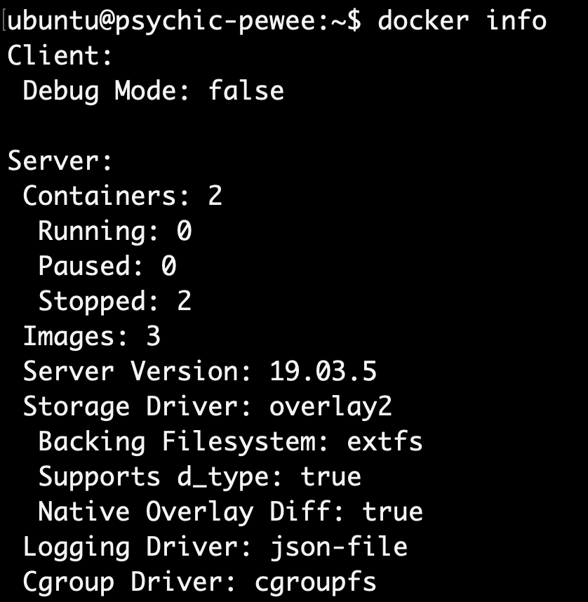
Docker Client
> docker info
Partial output shown. Lists out configuration details

Slide 14
Container Life-Cycle

Slide 15

States
Exited
Docker Hub
> docker stop/kill
> docker start
> docker pull
Created
Started
Dead
> docker create
> docker start
> docker run
> docker pause
> docker unpause
Paused

Slide 16
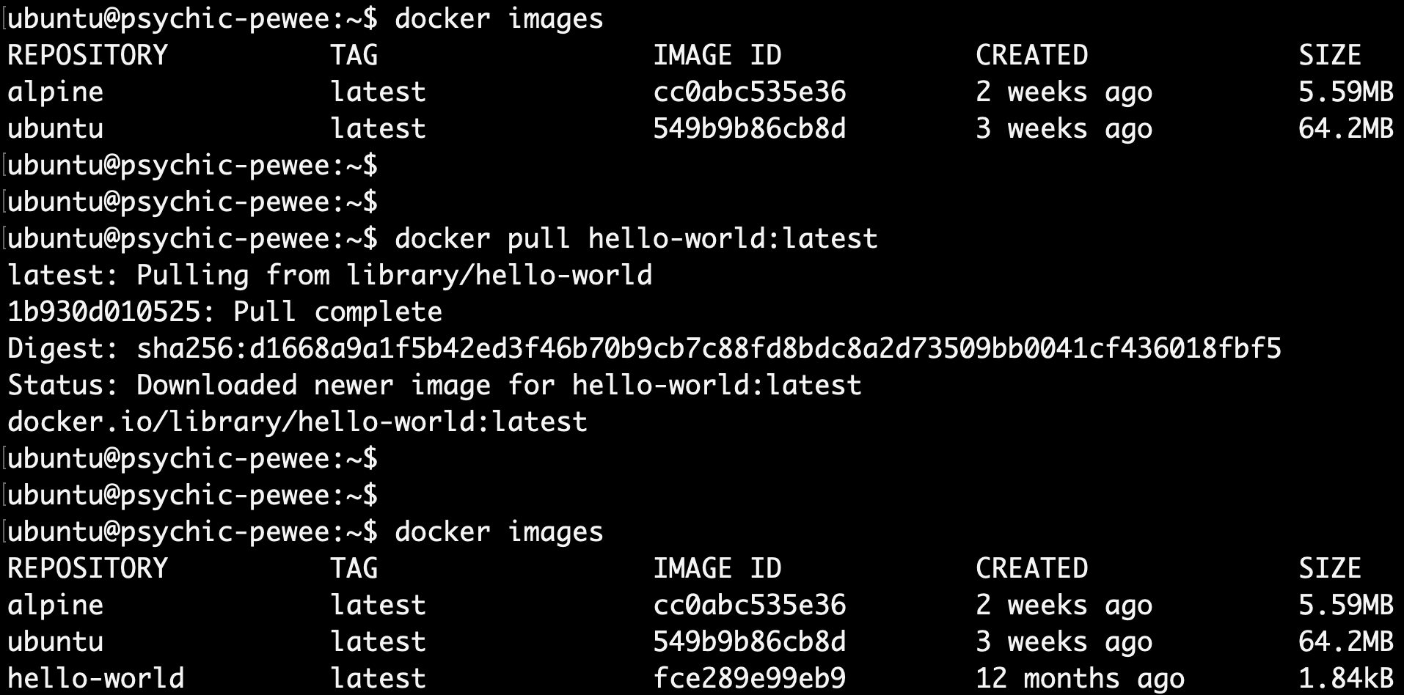
> docker pull
Pull the helloworld-latest image from DockerHub default registry

Slide 17
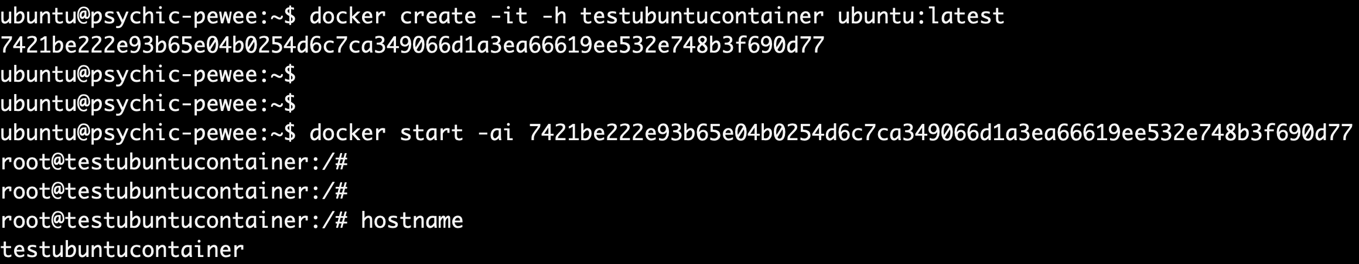
> docker create-start/run
Create-Start: Creates a container with ubuntu image, sets the hostname and start the container separately
Run: Creates and starts the container in one-shot. Note the hostname (configured using –hostname option) displayed below

Slide 18
> docker run
If the docker image is not available, docker run communicates with docker daemon (which in turn communicates with registry and storage driver) to fetch the image from the registry, stores it into the local cache. If it is already available in the local cache, the available image is used.
The daemon then instructs the execution driver to start-up the container with the parameters passed in the docker run command-line.
Registries
Docker Client (Eg. CLI)
Docker Daemon
Execution Driver
Docker Remote API
Storage Driver
Containers
Local Repositories

Slide 19
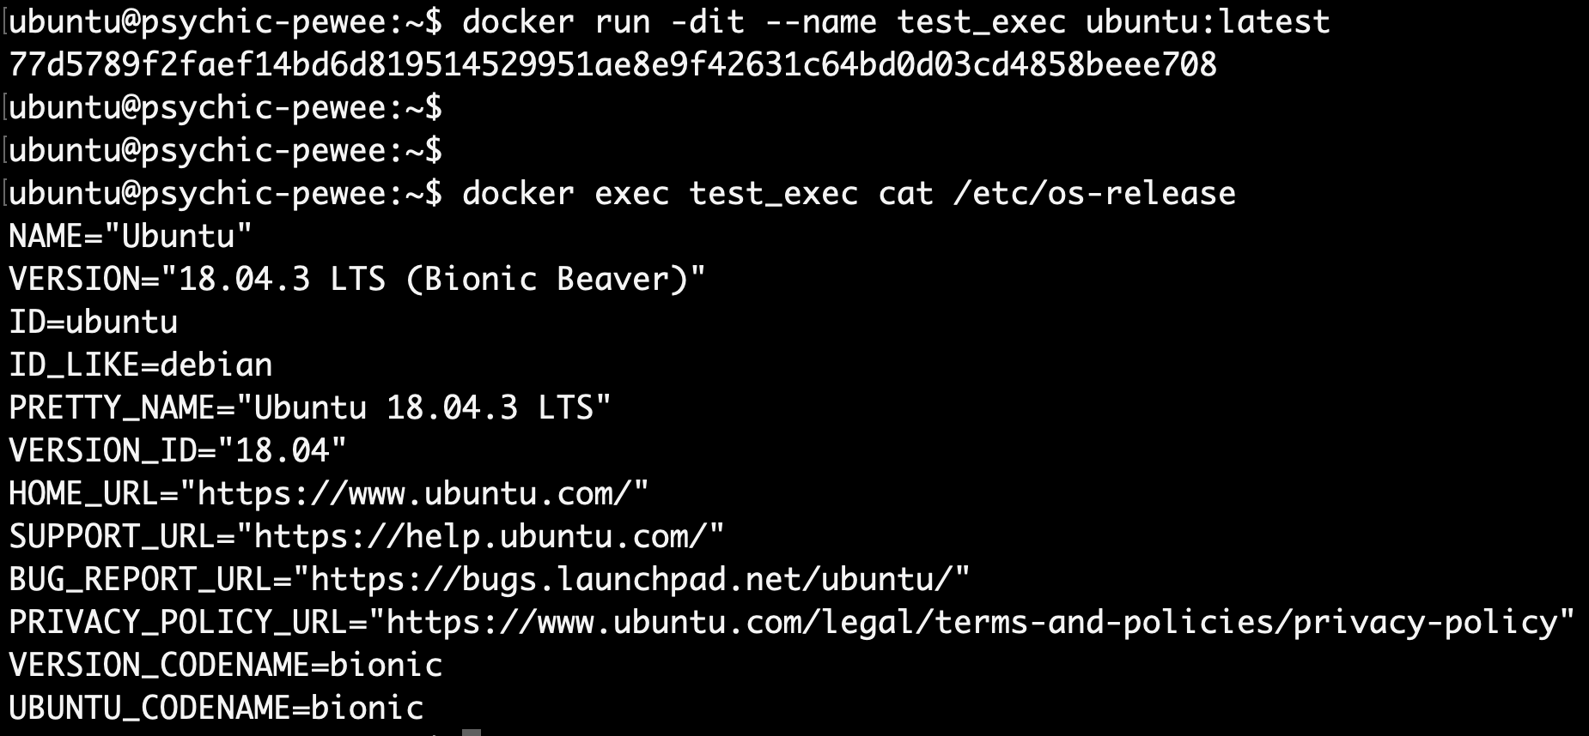
> docker exec
Exec helps in running commands within a container. Above example illustrates the cat /etc/os-release command being run inside the container.

Slide 20
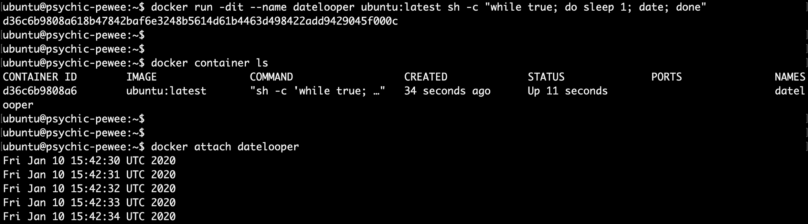
> docker attach
Create and run a container in detached mode. The test script here loops forever and prints date every second.
List the containers to check if the container is active
Attach to container so that the test message echoed to stdout could be seen.

Slide 21
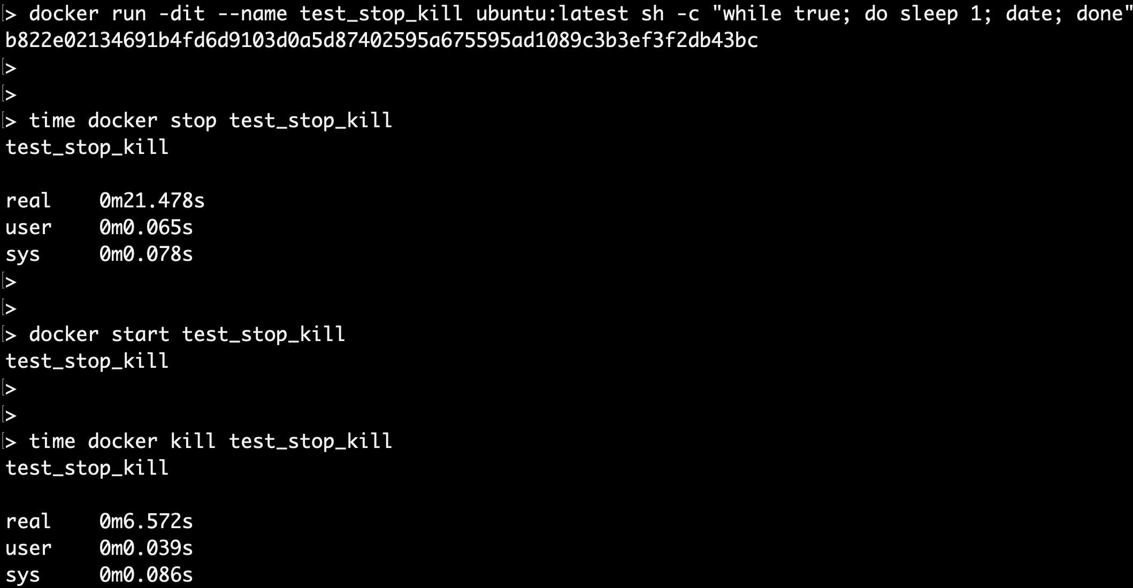
> docker stop/kill
Stop: Graceful (Note the grace period given for the container to cleanup
Kill: Much faster

Slide 22
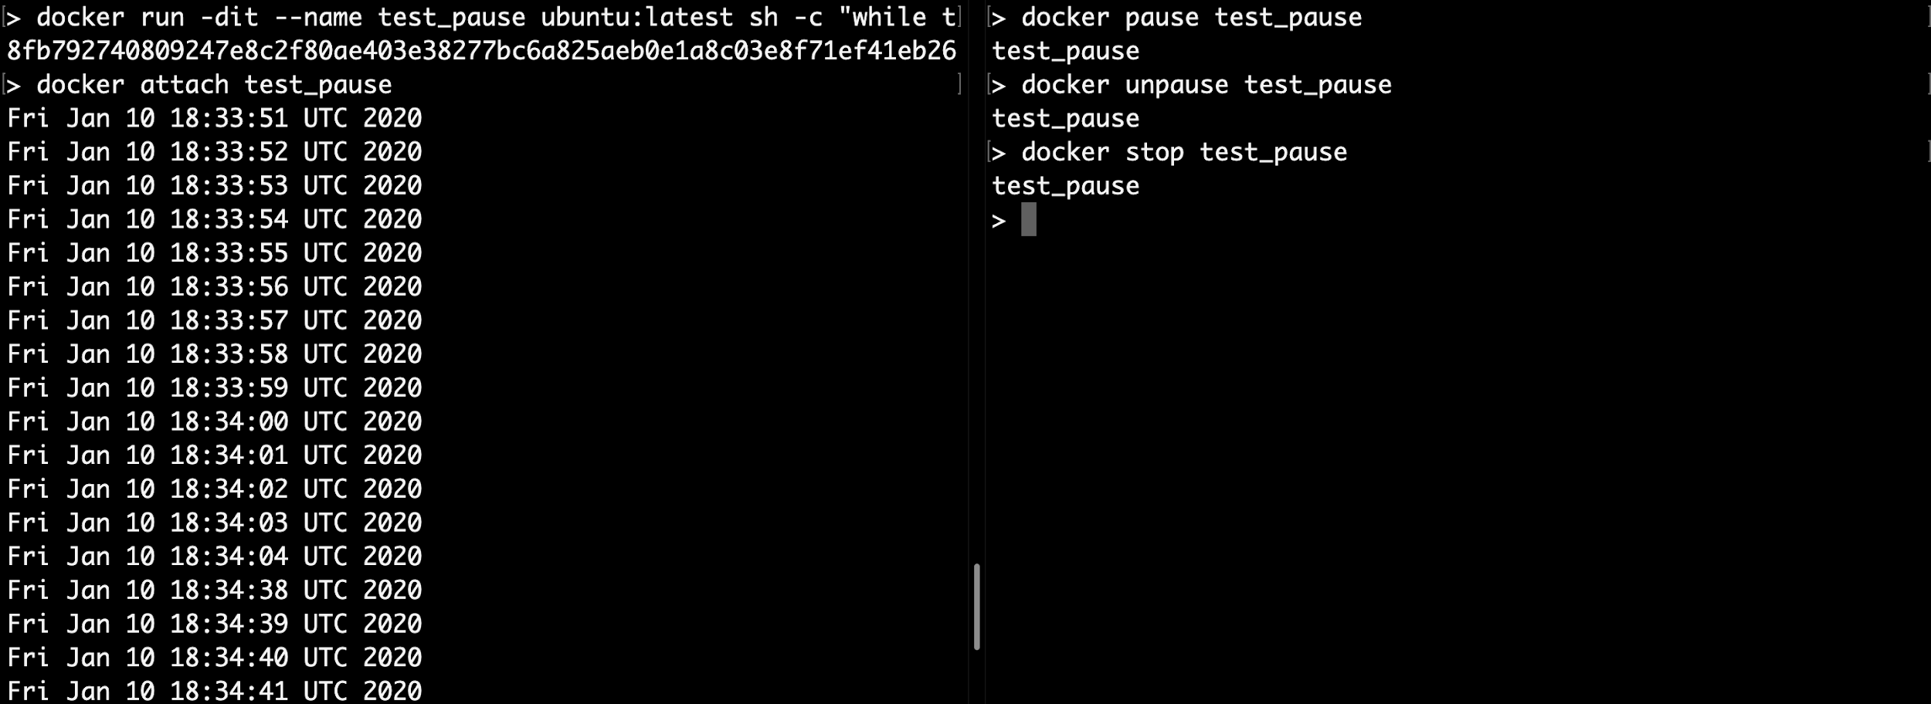
> docker pause/unpause
Pause and unpause moments differ by 34 seconds during which the container remained paused.

Slide 23
Docker Images: Creation And Management

Slide 24
Dockerfile
The Dockerfile is a file which a user could define using a set of pre-specified instructions so that the docker daemon could execute these instructions on a temporary container and commit the changes indicated by the instructions so as to create an image the user requires.
In the illustration shown, the dockerfile instructions are explained below:
FROM is the first instruction and specifies the base image over which rest of the image is layered.
RUN executes a command within the container. In the illustration, it is used twice. First to update the package repository and second to create a directory.
WORKDIR sets the working directory.
ENV can be used to pass environment variables to the container.
VOLUME indicates that the directory created previously should persist across container runs.
COPY is used to copy files into the image.
CMD provides default execution parameters for containers. It could be overridden if required during docker run.
FROM ubuntu:latest
MAINTAINER Swapnajit Patil(sp@gmail.com)
RUN /bin/bash
Sample Dockerfile which uses a ubuntu:latest base image, injects the shell script from above as a layer and sets it as the startup script.

Slide 25
> docker build
Sending build context to Docker daemon 3.072kB
Step 1/3 : FROM ubuntu:latest
---> 72300a873c2c
Step 2/3 : MAINTAINER Swapnajit Patil(sp@gmail.com)
---> Using cache
---> 3b0e6f79ebe0
Step 3/3 : RUN /bin/bash
---> Using cache
---> 53073d2cf17f
Successfully built 53073d2cf17f
Successfully tagged test:latest
In the snapshot the docker build command used is:
> docker build . –t test:latest
In this illustration (abridged output), the above command is executed within the folder which contains the DockerFile.
The command accepts the docker file as input and a image-tag (-t) which is the name of the image (test) and the corresponding tag (latest).

Slide 26
Networking Containers

Slide 27
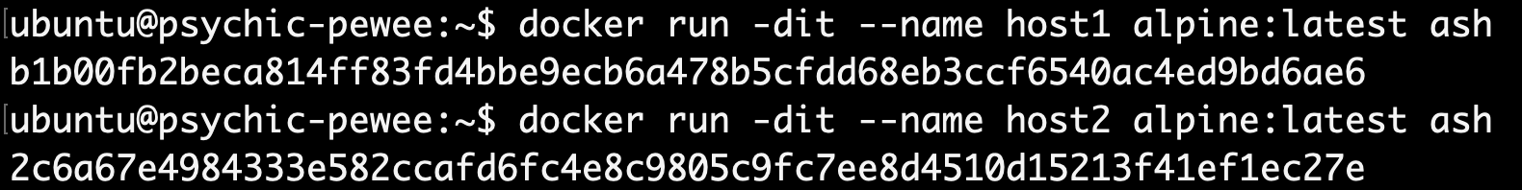
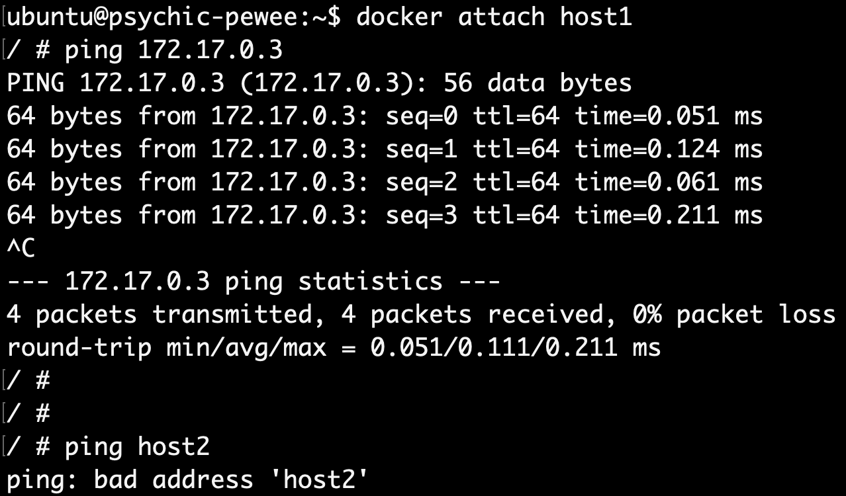
Using Default Network Bridge
Created two alpine-linux containers. Implicitly assigned IP addresses are as follows:
[host1: 172.17.0.2, host2: 172.17.0.3]
Pinging using IP addresses works. But ping fails with container name! This is because default bridge does not support automatic service discovery.

Slide 28
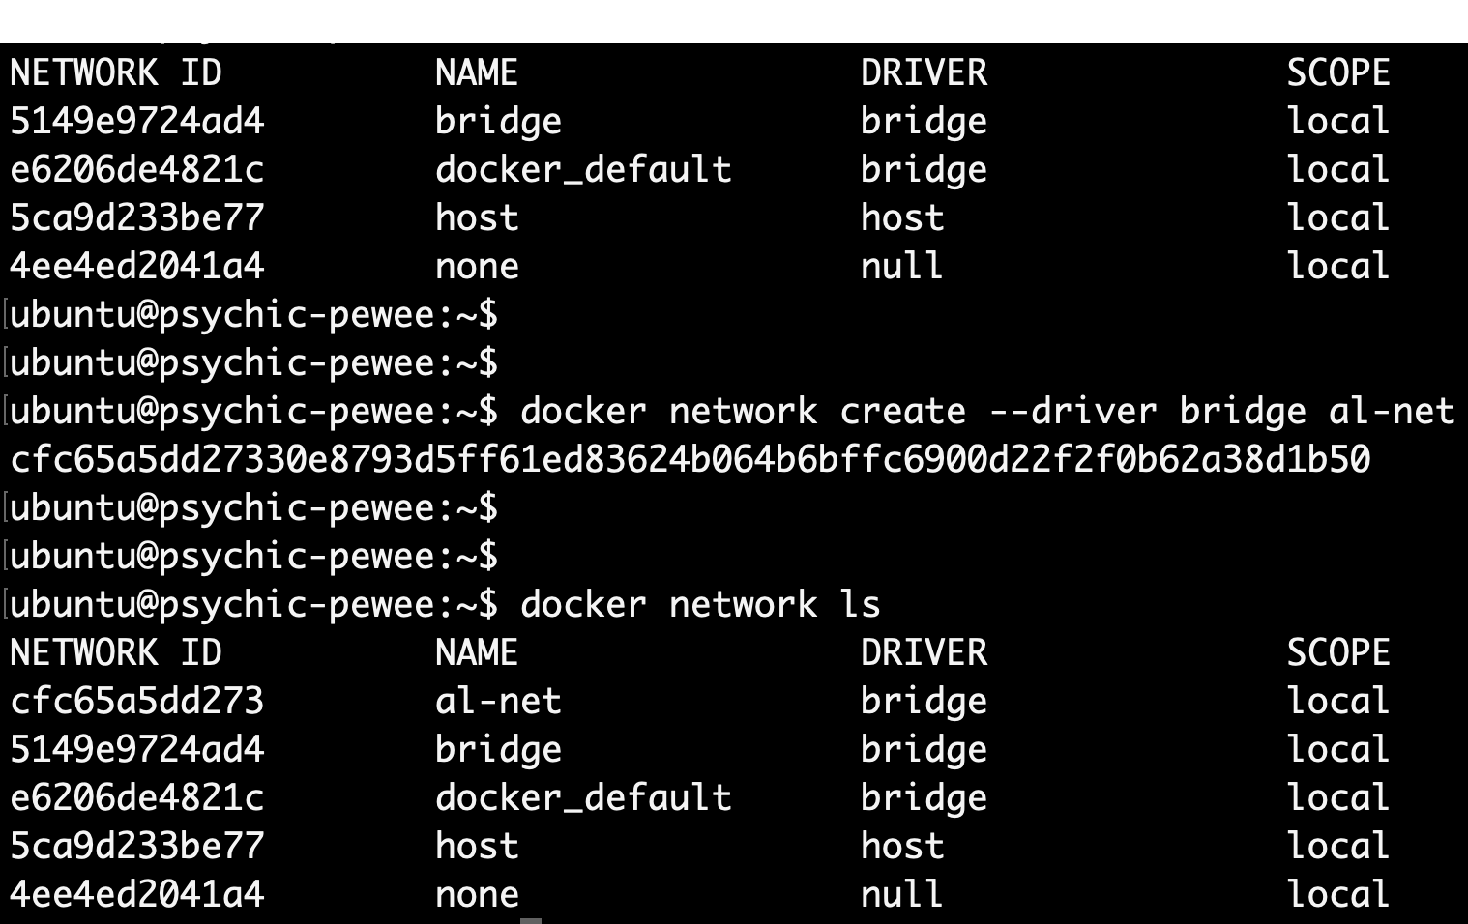
Creating User-Defined Bridge

Slide 29
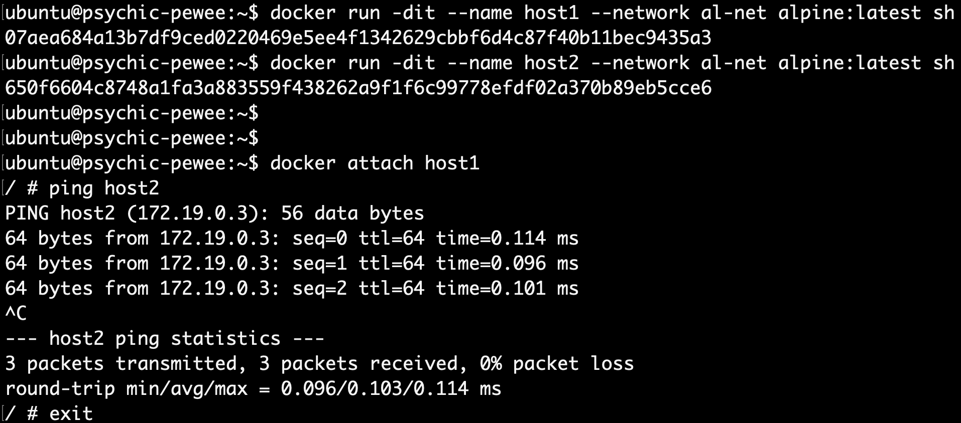
Using User-Defined Network Bridge

Slide 30
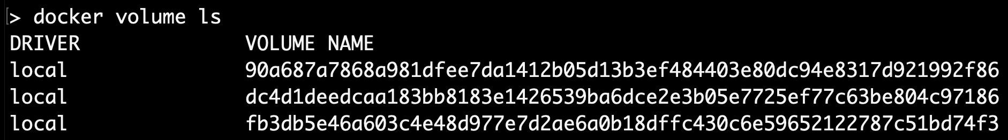
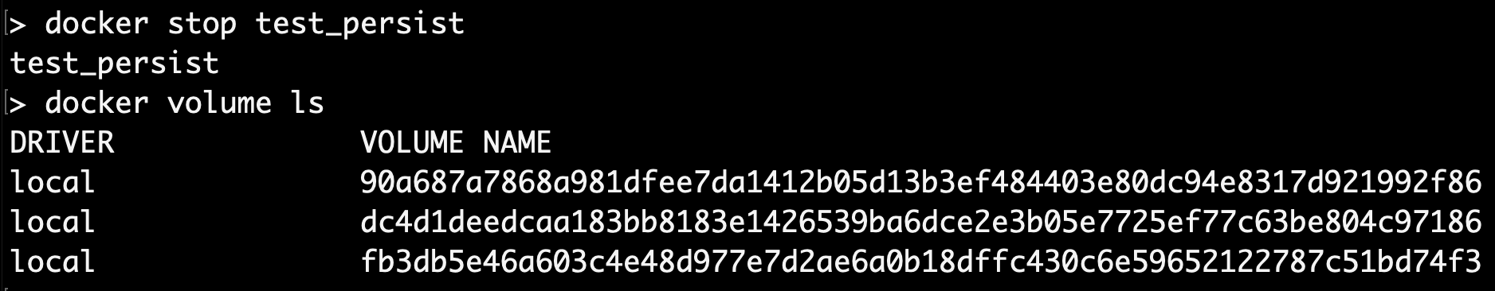
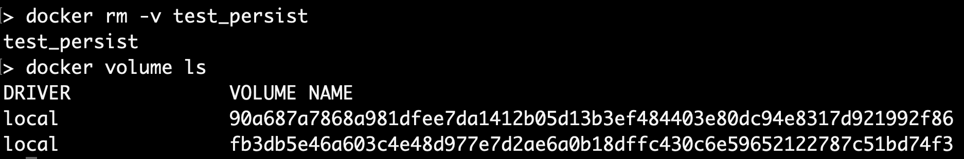
> docker rm
Volume created for test_persist container
Does not go away even after > docker stop
> docker rm Removes the container along with any volume definitions. This is useful to cleanup stale volumes.

Slide 31
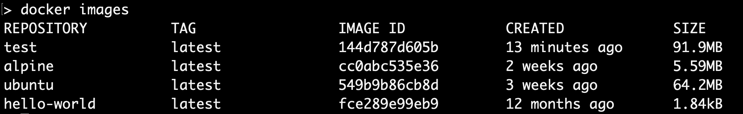
> docker images
Lists all the images (also includes the image created in the previous step) available in the local cache

Slide 32
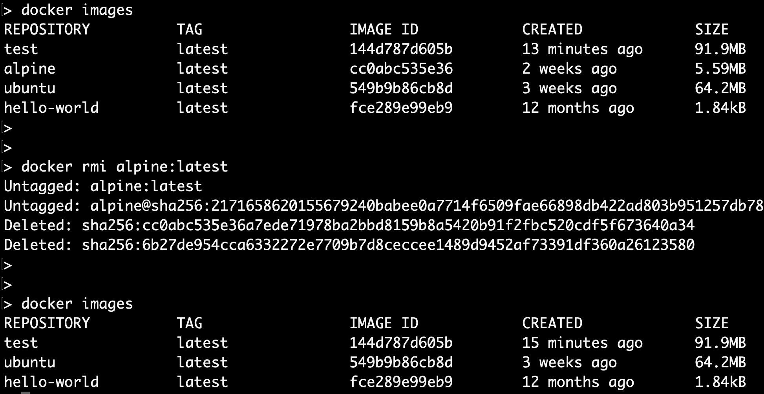
> docker rmi
Removes the image from the local repository cache

Slide 33
Other Docker Command Utilities
docker volume
docker cp
docker commit
docker history
docker load/save

Slide 34
Docker Compose

Slide 35
Introduction
Docker compose allows the user to configure and run one or more containers as services.
Using docker compose, we could set configurations of the containers, decide on the order of boot-up, volumes to be mounted, networking between containers and more.
We illustrate a very simple use-case of docker-compose in the next slide.

